Slide 1
NoSQL
Module 18

Slide 2
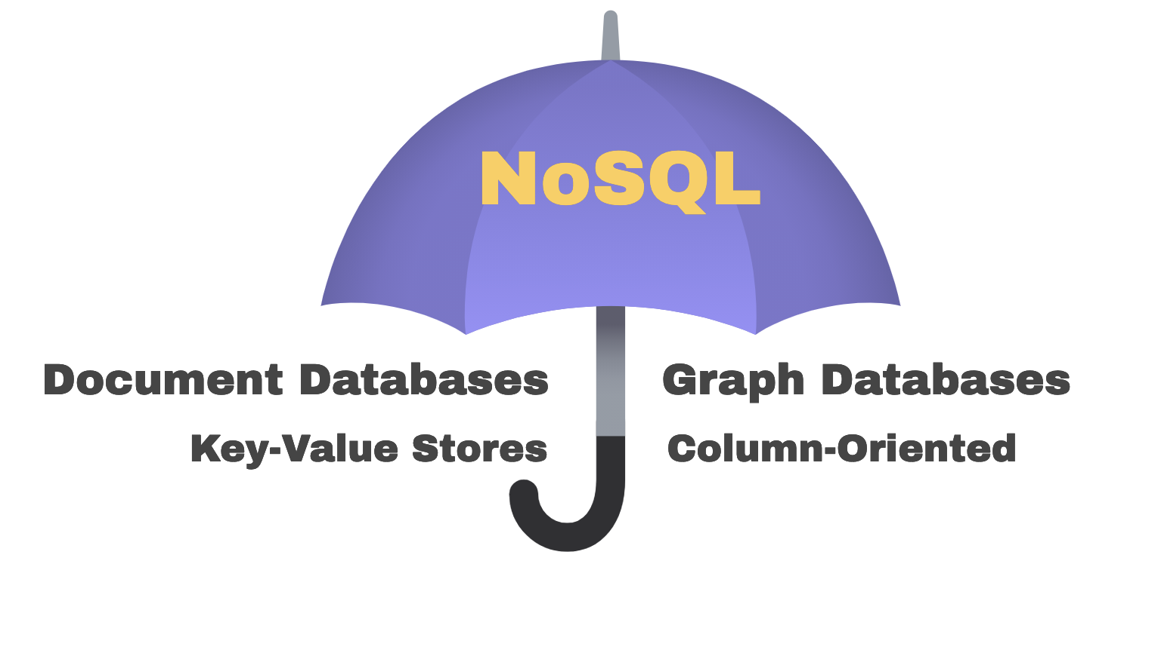
What Is NoSQL?
NoSQL is an umbrella term for any database that is not a traditional, relational SQL database. There are four main types of NoSQL databases.

Slide 3
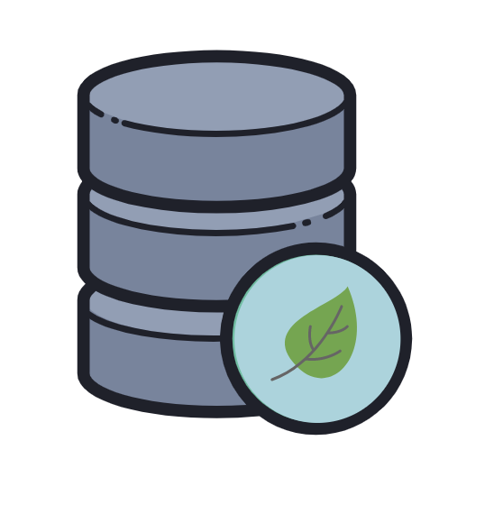
How Do NoSQL Databases Store Data?
While NoSQL databases are all non-relational, each type of NoSQL database stores data in a unique way and is used differently by developers. In this unit, we focus on
MongoDB, a general purpose NoSQL, document database that uses documents to store data. MongoDB works well with JavaScript because it stores data in objects.

Slide 4
How Does MongoDB Store Data Differently from SQL Databases?

Slide 5
SQL Is a Relational Database
SQL uses rows and tables to store data, enforcing a rigid schema.
Table
Order_ID | Customer_ID | Date_ID
10001 | d005458dtsf | 6/26/2019
10002 | d007sfgs847 | 8/3/2018
10003 | d004fgsfh445 | 12/3/2018
Rows

Slide 6
SQL Is a Relational Database
Because SQL is a relational database, SQL also relies on joins to combine related data from different tables.
Customer_ID | Date_ID
d005458dtsf | 6/26/2019
d007sfgs847 | 8/3/2018
d004fgsfh445 | 12/3/2018
Order_ID | Customer_ID | Date_ID
10001 | d005458dtsf | 6/26/2019
10002 | d007sfgs847 | 8/3/2018
10003 | d004fgsfh445 | 12/3/2018

Slide 7
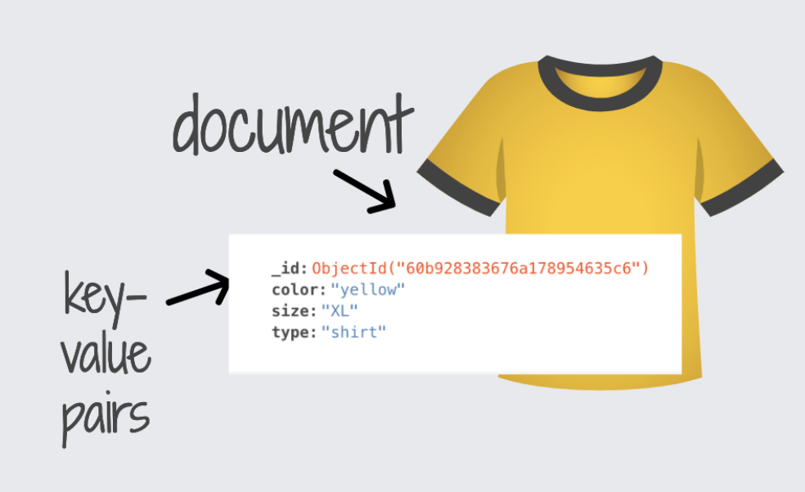
MongoDB
MongoDB Uses Documents and Objects Instead of Tables and Rows
MongoDB stores data in objects stored in a format called BSON, or Binary JSON. BSON looks and acts just like JSON, but is optimized for faster parsing.

Slide 8
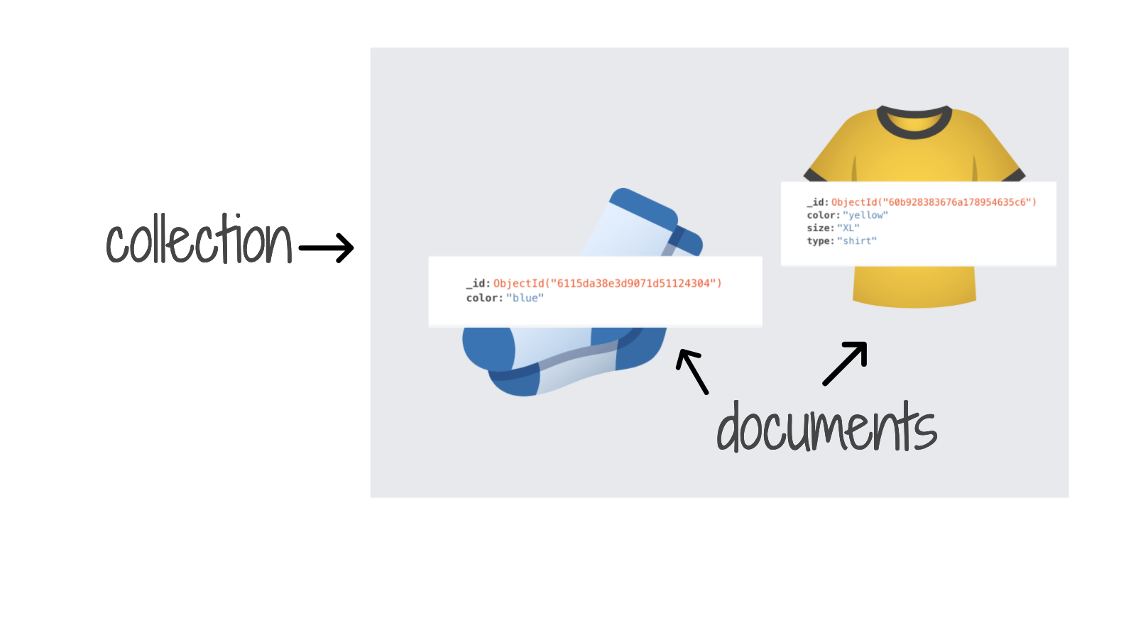
Groups of Documents Are Stored in Collections
Unlike SQL tables, collections do not have an enforced schema to limit the type of data stored. Each document in a collection can have different fields (keys) and can contain different types of data.

Slide 9
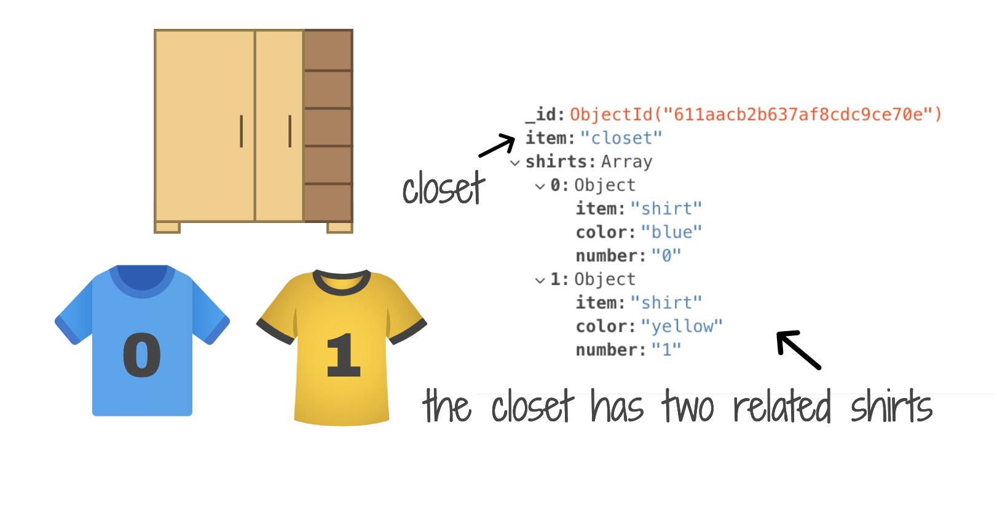
Related Data Can Be Stored in Embedded Documents
Unlike SQL, related data in MongoDB is not split between tables. Instead, related data is nested within a single object as an embedded document.

Slide 10
SQL vs. MongoDB
Let’s compare how data is stored in SQL vs. MongoDB databases:
SQL, Relational Database | Database
 | Table (rigid schema)
 | Row
 | Column
 | Related data split between tables
MongoDB, NoSQL, Non-Relational | Database
 | Collection (No enforced schema)
 | Document (BSON object)
 | Field (Key)
 | Related data nested in embedded document

Slide 11
So Why Use MongoDB?
The following are some reasons for why developers choose MongoDB:
MongoDB stores data as a BSON object, making it a great fit for JavaScript apps.
MongoDB does not use tables or enforce a rigid schema, allowing more flexibility for developers.
MongoDB is a great choice for heterogeneous data, and scales easily.
MongoDB is capable of storing related data well.

Slide 12
Mini-Project

